Slide 1
Data Snooping
Explained for Beginners
Snooping by visualization?
Snooping by pre-processing?
Snooping by other’s work?

Slide 2
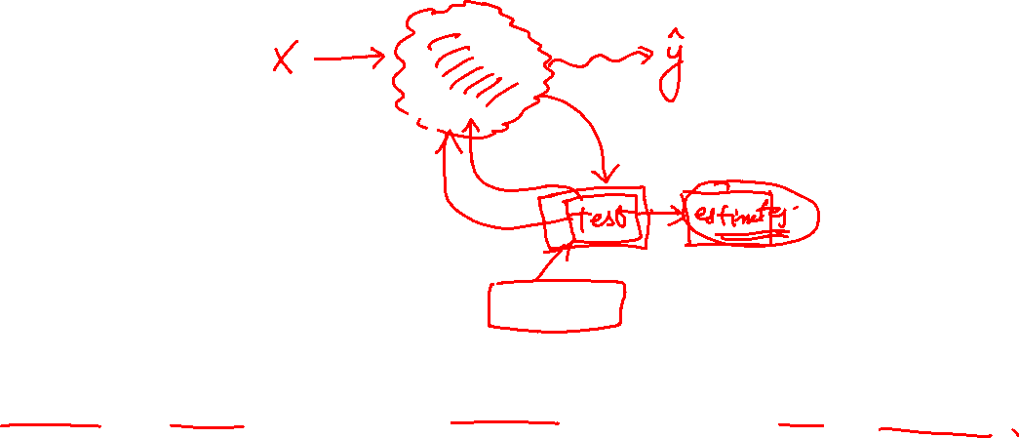
Data Snooping
If a dataset has affected any step in the learning process, its ability to assess the outcome has been compromised

Slide 3
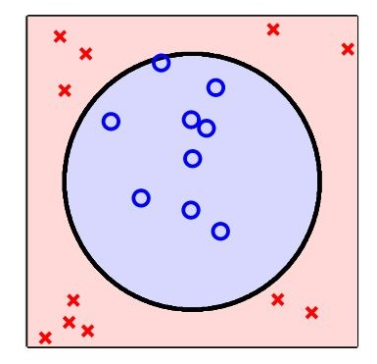
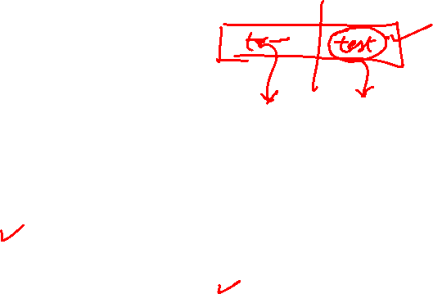
Data Visualizations

Slide 4
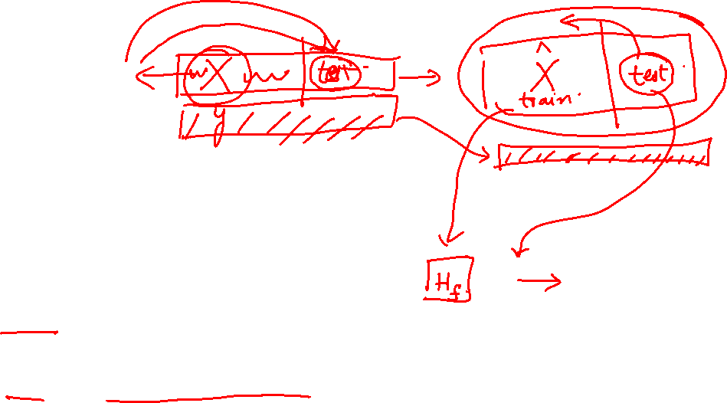
Data Pre Processing

Slide 5
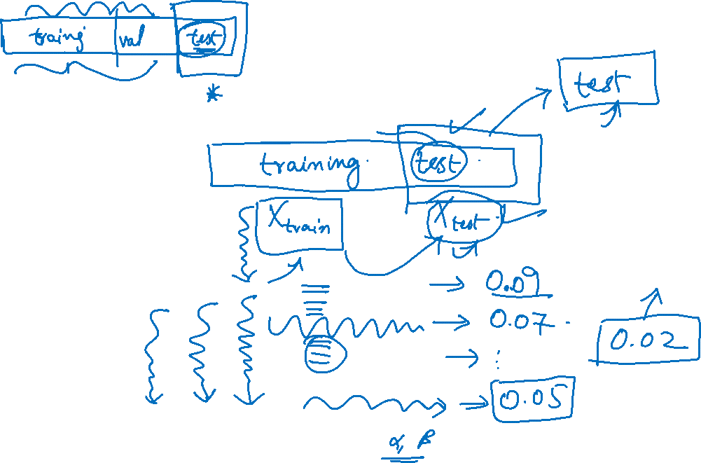
Using Other’s Work

Slide 6
Website : www.aisciences.io

